Slide 1
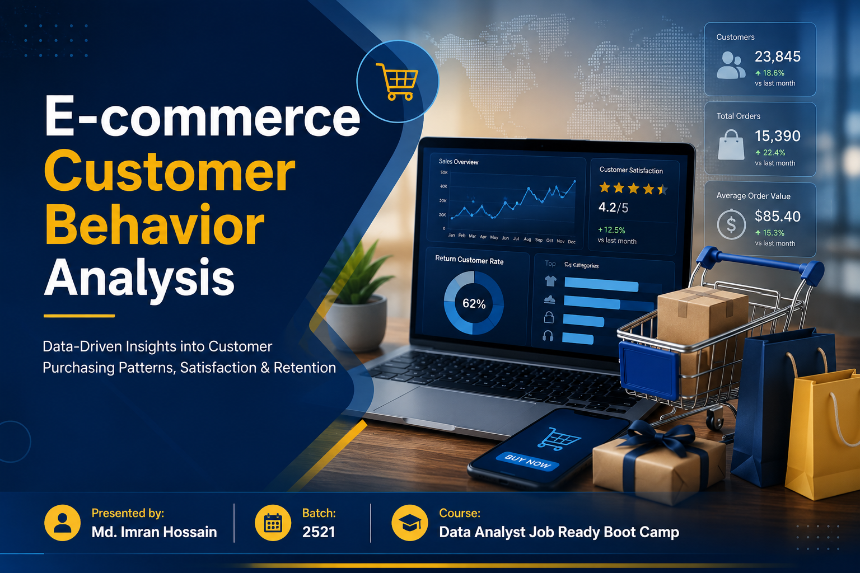

Slide 2
Problem Statement
The purpose of this project is to analyze customer purchasing behavior, satisfaction, and retention patterns in an e-commerce platform using Python. Through data analysis and visualization, the project aims to identify key business insights related to customer engagement, payment methods, delivery performance, and purchasing trends to support better business decision-making.

Slide 3
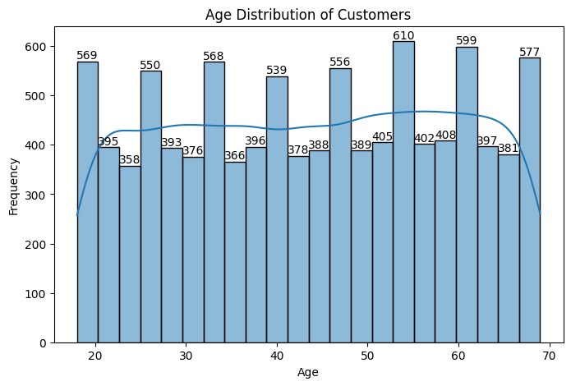
Level-1: Q-1: Find Mean, Median, and Mode (Age)
Interpretation:
The average customer age is around 44 years. Most customers fall within the middle-age group, and the most frequent age among customers is 51.
The age distribution appears fairly balanced with moderate concentration around the median age.
Business Insights:
The business should target marketing campaigns toward the dominant customer age group, as they represent the majority of purchasing activity.
Age-based personalization and product recommendations may improve customer engagement and conversion rates.

Slide 4
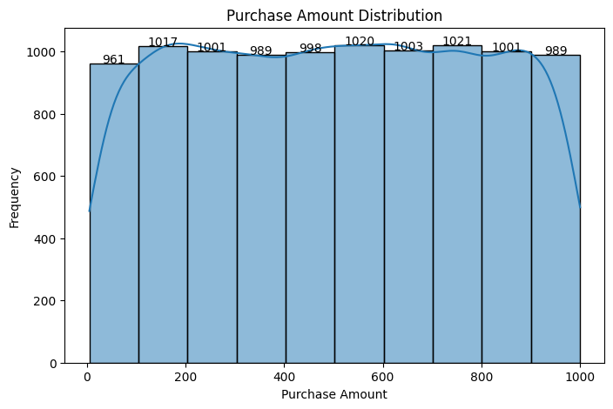
Level-1: Q-2: Variance, Standard Deviation, and Z-Score (Purchase Amount):
Interpretation:
The standard deviation indicates how much customer purchase amounts vary from the average purchase value. A higher variance suggests that customer spending behavior differs significantly across transactions. The z-score helps identify unusual purchase behaviors and potential outliers among customers.
Business Insights:
Customers show varying spending patterns, indicating the presence of both low-value and high-value buyers. The business can segment customers based on spending behavior and design personalized marketing campaigns for high-spending customers.

Slide 5
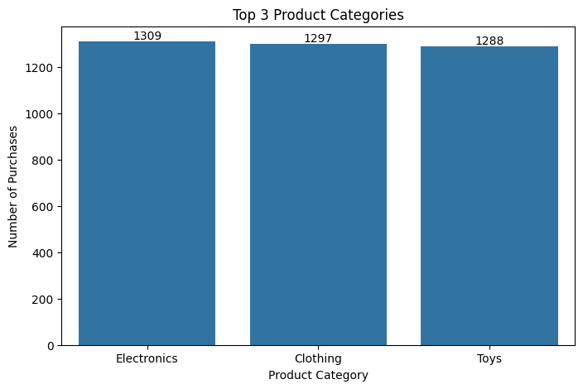
Level-1: Q-3: What are the top three product categories based on the number of purchases?
Interpretation:
The analysis shows that the top product categories generate the highest number of purchases among customers. These categories dominate customer demand and contribute significantly to overall transaction volume.
Business Insights:
The company should prioritize inventory management and promotional campaigns for the highest-performing product categories. Focusing on customer-preferred categories can improve sales performance and customer satisfaction.

Slide 6
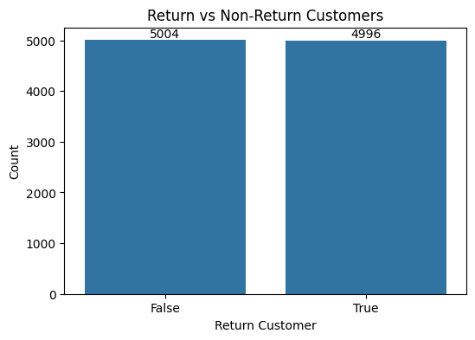
Level-1: Q-4: How many customers are classified as return customers?
Interpretation:
The analysis shows the number of customers who made repeat purchases from the platform.
A higher number of return customers indicates strong customer retention and repeat purchasing behavior.
Business Insights:
The business should focus on maintaining customer loyalty through personalized offers, loyalty programs, and improved customer experience.
Increasing return customers can significantly improve long-term revenue and profitability.

Slide 7
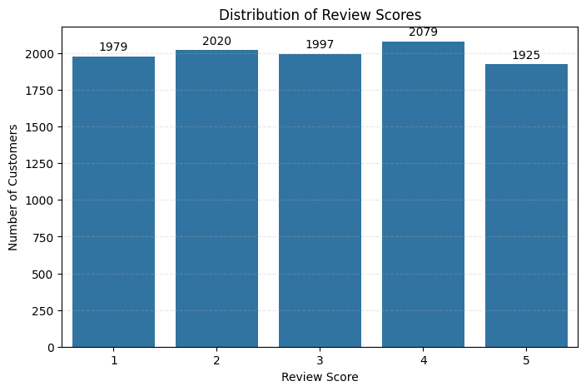
Level-1: Q-5: What is the average review score given by customers?
Interpretation:
The average review score indicates the overall customer satisfaction level with the products and services. Most customers provided moderate to high ratings, suggesting generally positive customer experiences.
Business Insights:
Maintaining high review scores is important for customer retention and brand reputation. The business should continue improving product quality, delivery service, and customer support to increase satisfaction levels further.

Slide 8
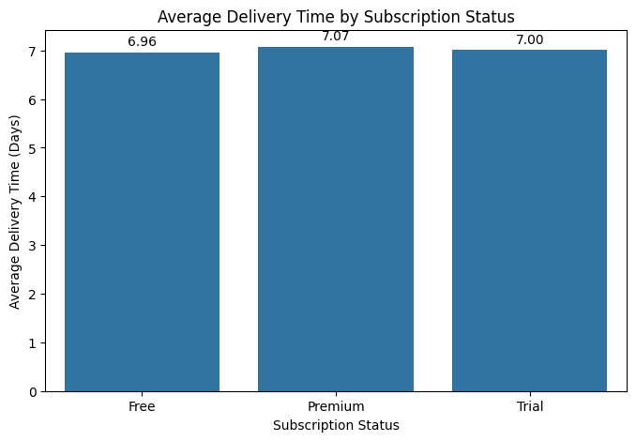
Level-1: Q-6: How does the average delivery time vary between subscription statuses (Free, Premium)?
Interpretation:
The analysis shows differences in delivery performance across subscription types. Premium customers generally experience faster delivery times compared to free users, indicating prioritized service for higher-tier subscribers.
Business Insights:
Faster delivery for premium users can increase customer satisfaction and encourage subscription upgrades.
The company can use delivery speed as a key marketing advantage for premium membership plans.

Slide 9
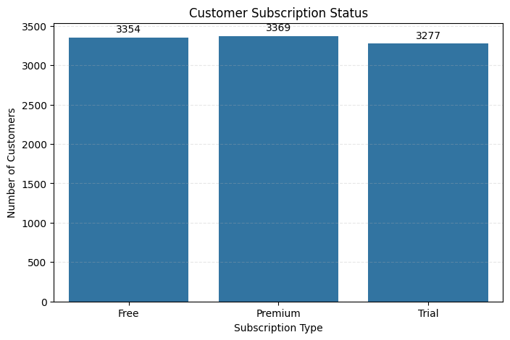
Level-1: Q-7: How many customers are subscribed to the service?
Interpretation:
The analysis shows the distribution of customers across different subscription plans.
Free users represent a significant portion of the customer base, while premium and trial users contribute to the platform’s active subscriber segment.
Business Insights:
The company should focus on converting free users into premium subscribers through targeted promotions, exclusive benefits, and improved customer experience.
Increasing premium subscriptions can improve recurring revenue and long-term customer retention.

Slide 10
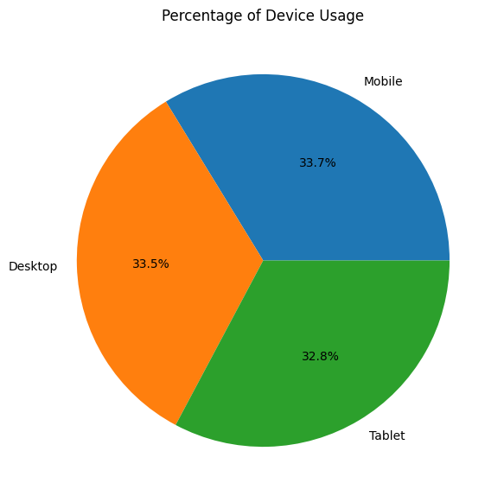
Level-1: Q-8: What is the average purchase amount for customers who availed discounts compared to those who didnʼt?
Interpretation:
The analysis shows that customers primarily use certain devices more frequently for online purchases.
Mobile devices contribute the highest percentage of transactions, indicating strong mobile shopping behavior among customers.
Business Insights:
The company should optimize the shopping experience for the most-used device platform to improve customer engagement and conversion rates.
Mobile-friendly design, faster loading speed, and responsive interfaces can significantly enhance customer satisfaction and sales performance.

Slide 11
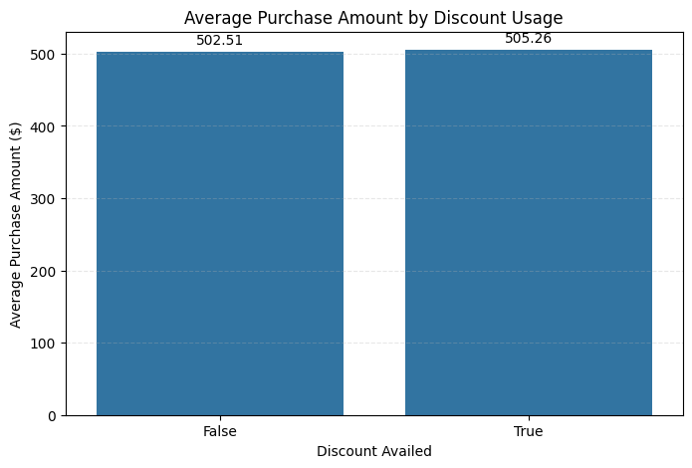
Level-1: Q-9: What is the average purchase amount for customers who availed discounts compared to those who didnʼt?
Interpretation:
The analysis compares customer spending behavior between customers who availed discounts and those who did not.
Customers who received discounts tend to show different purchasing patterns, indicating that discounts may influence buying behavior and spending levels.
Business Insights:
Discount campaigns can encourage customers to spend more and increase transaction value.
The company should optimize promotional strategies by targeting customer segments that respond positively to discounts.

Slide 12
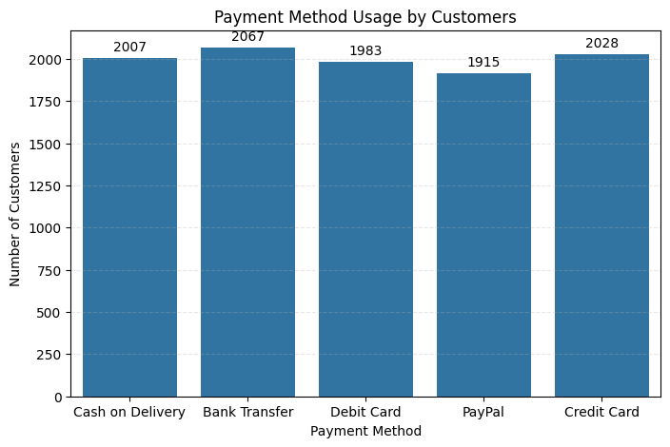
Level-1: Q-10: What is the most common payment method used by customers?
Interpretation:
The analysis identifies the most frequently used payment method among customers.
The dominant payment method reflects customer purchasing preferences and transaction convenience.
Business Insights:
The company should optimize and prioritize the most-used payment method to ensure smooth transactions and improved customer experience.
Offering secure and convenient payment options can increase customer trust and conversion rates.

Slide 13
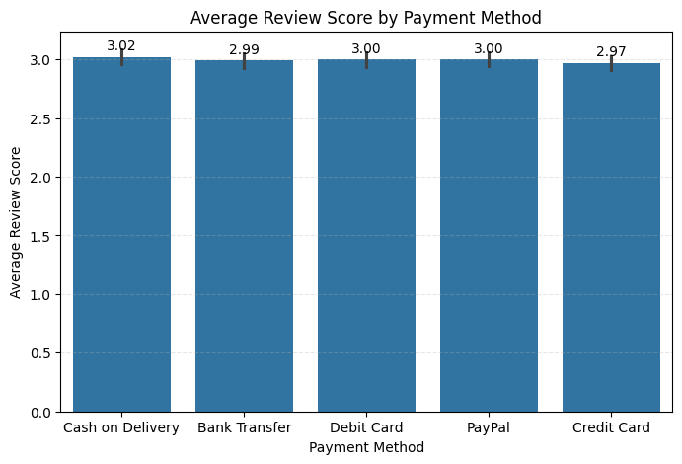
Level-2: Q-1: What are the average review scores of users of the most common payment method?
Interpretation:
The analysis shows the average review score of customers using the most preferred payment method.
Customers using the most common payment method generally provide positive review scores, indicating a satisfactory transaction experience.
Business Insights:
The business should ensure that the most-used payment method remains secure, reliable, and user-friendly to maintain customer satisfaction.
Improving payment convenience can positively influence customer experience and future purchases.

Slide 14
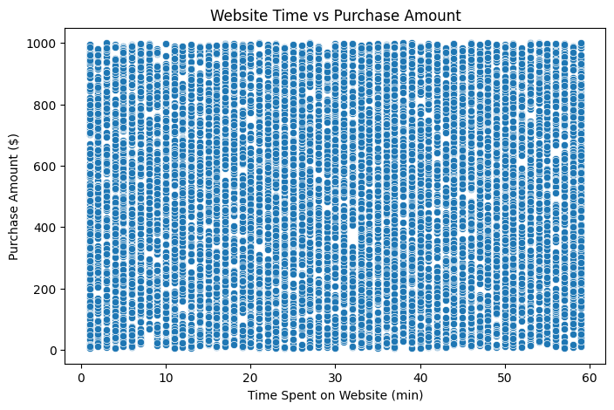
Level-2: Q-2: What is the correlation between time spent on the website and purchase amount? Do customers who spend more time on the website purchase more items?
Interpretation:
The analysis shows a positive relationship between the time customers spend on the website and their purchase amount.
Customers who spend more time browsing the website tend to purchase more products and generate higher transaction values.
Business Insights:
Improving customer engagement on the website can increase purchase activity and overall revenue.
The company should focus on personalized recommendations, better user experience, and engaging product displays to encourage customers to spend more time on the platform.

Slide 15
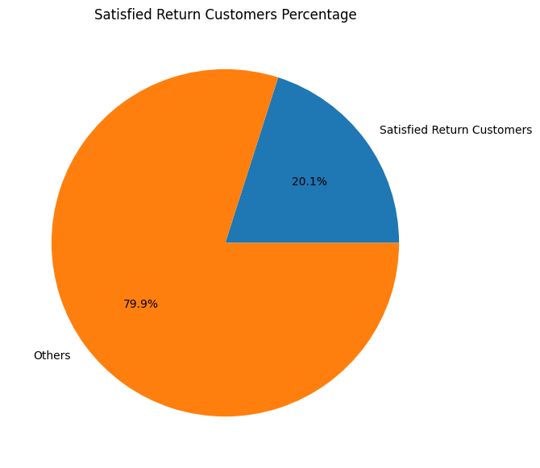
Level-2: Q-3: What percentage of customers are satisfied (rating of 4 or 5) and are also return customers?
Interpretation:
The analysis identifies customers who are both satisfied with their shopping experience and have returned for repeat purchases.
A significant percentage of satisfied return customers indicates strong customer loyalty and positive customer experience.
Business Insights:
Satisfied return customers are valuable for long-term business growth and profitability.
The company should strengthen loyalty programs, improve customer service, and maintain product quality to retain high-value customers.

Slide 16
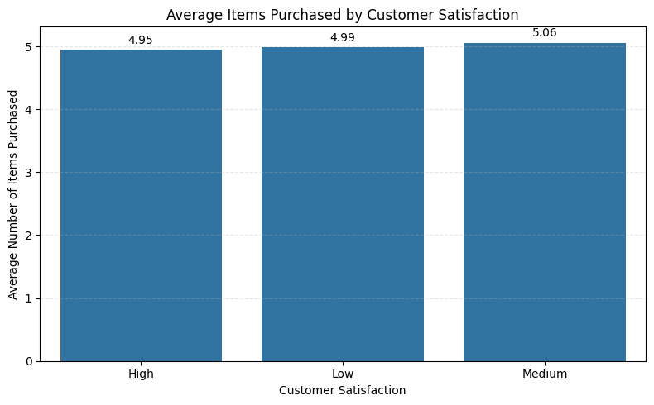
Level-2: Q-4: What is the relationship between the number of items purchased and customer satisfaction?
Interpretation:
The analysis shows a relationship between customer satisfaction levels and purchasing behavior.
Customers with higher satisfaction levels tend to purchase more items compared to customers with lower satisfaction levels.
Business Insights:
Improving customer satisfaction can positively influence customer purchasing behavior and increase sales volume.
The company should focus on better customer experience, product quality, and service efficiency to encourage repeat and larger purchases.

Slide 17
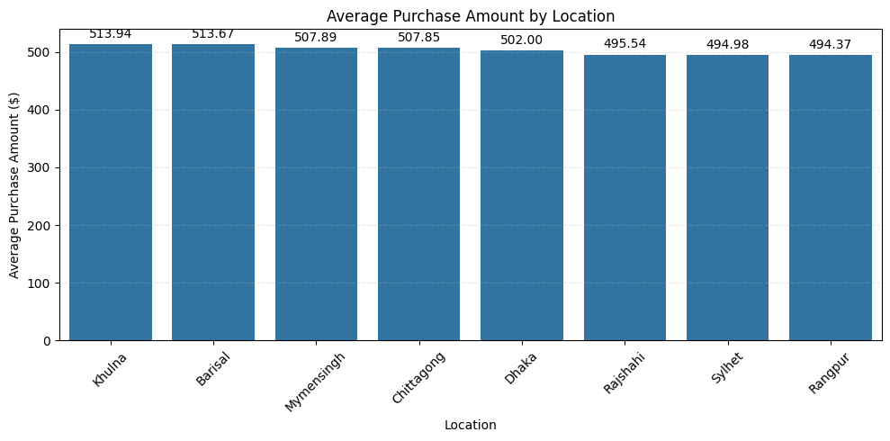
Level-2: Q-5: Which location has the 2nd highest average purchase amount?
Interpretation:
The analysis compares average purchase amounts across different locations.
The location with the second-highest average purchase amount demonstrates strong customer spending behavior and significant market potential.
Business Insights:
The company should strengthen marketing and operational strategies in high-performing locations to maximize revenue opportunities.
Locations with high average spending may offer strong potential for premium product promotions and customer retention campaigns.

Slide 18
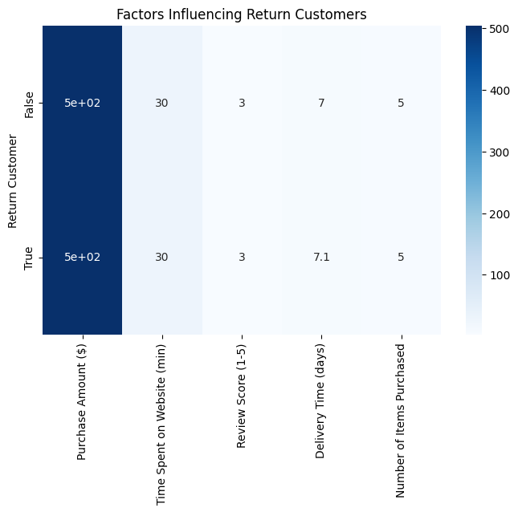
Level-3: Q-1: What factors contribute most to a customer being classified as a return customer?
Interpretation:
The analysis indicates that customer satisfaction, purchase amount, website engagement, and subscription status strongly influence whether a customer becomes a return customer.
Customers who spend more time on the website, purchase more items, and provide higher review scores are more likely to return for future purchases.
Business Insights:
Improving customer satisfaction, delivery efficiency, and website engagement can significantly increase customer retention.
The company should focus on personalized recommendations, loyalty programs, and premium customer experiences to encourage repeat purchases.

Slide 19
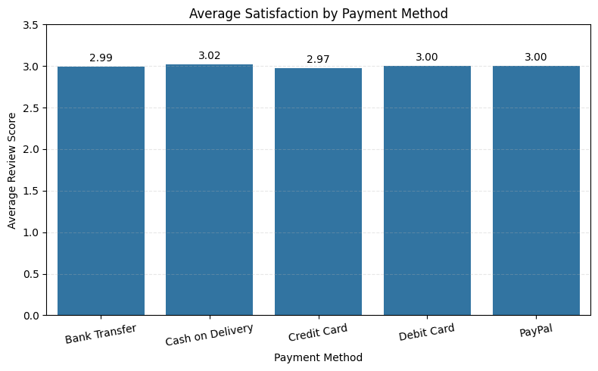
Level-3: Q-2: How do payment methods influence customer satisfaction and return rates?
Interpretation:
The analysis shows that customer satisfaction and return behavior vary across different payment methods.
Customers using certain payment methods tend to provide higher review scores and demonstrate stronger return customer behavior, suggesting that payment convenience and trust influence customer experience.
Business Insights:
The company should optimize secure and convenient payment systems to improve customer satisfaction and retention. Promoting trusted digital payment methods may encourage repeat purchases and enhance overall customer experience.

Slide 20
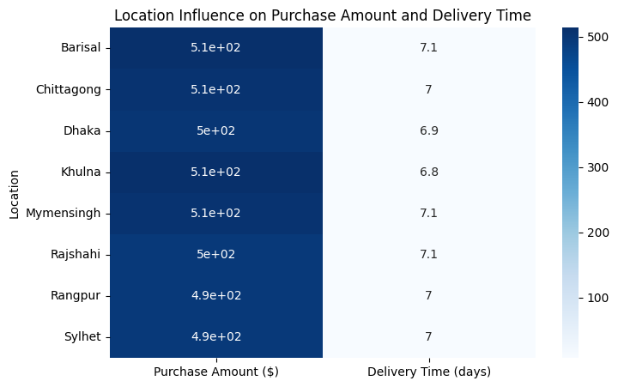
Level-3: Q-3: How does the location influence both purchase amount and delivery time?
Interpretation:
The analysis shows that customer purchasing behavior and delivery performance vary across different locations. Certain locations generate higher average purchase amounts, while some areas experience longer delivery times, indicating regional differences in customer demand and logistics efficiency.
Business Insights:
The company should improve logistics and delivery operations in locations with slower delivery performance to enhance customer experience. High-performing locations with strong purchase activity can be targeted for premium marketing campaigns and inventory expansion.

Slide 21
Level-3: Q-4: What major insights are found? Give a proper explanation.
Final Conclusion
The overall analysis shows that customer satisfaction, website engagement, delivery efficiency, payment convenience, and promotional strategies significantly influence customer purchasing behavior and retention.
The business can improve long-term growth by focusing on:
- Better customer experience
- Faster delivery operations
- Personalized marketing
- Mobile-friendly platform optimization
- Stronger loyalty and subscription programs
- Efficient payment systems
Using data-driven decision-making will help the company improve customer retention, operational efficiency, and overall revenue performance.

Slide 22
Thank You

